Slide 1
III Corps and Fort Hood
Combatives
Tournament
14-17 DEC 2015

Slide 2
Agenda
Items for Decision
Overview (III Corps and Fort Hood Combatives)
Command and Control/Support (Phantom Warrior Academy)
Revisit Items for Decision

Slide 3
Items for Decision
CG’s participation
Uniform For Spectators During Finals
CG/CSM Coins
1
2
3
4
Phantom Warrior FRG food sales

Slide 4
Purpose
III Corps and Fort Hood conducts the 2015 Fort Hood Combatives Tournament 14 – 17 DEC 2015 at Kieschnick Gym.
Prepetuate Warrior Ethos
Spur on Combatives training across the Corps
Meet AR 350-1 requirement for Combatives competitions.

Slide 5
Fort Hood Combatives Championship Tournament
Tournament Finals (advanced rules) 17 1500-UTC DEC 15
Quarter final and Semifinals bouts (intermediate rules) 16 0900-UTC DEC 15
Preliminary bouts (standard rules) 15 1000-UTC DEC 15
Combatives Tournament Begin 15 0900 DEC 15
14 1700 DEC 15
Rehearsal/Walkthrough
14 0900-1600 DEC 15
Weigh Ins / Medical Screening
11 DEC 15
Set up Kieschnick Gym 0900
Date TBD
Pre Registration cut off date 09 1600 DEC 15
Brief CG
Date TBD
Date TBD
Pre Brief G3
Begin weekly IP’s

Slide 6
Responsibilities
Fort Hood Combatives NCOIC
Tournament execution
Referees
Bracketing
Dispute Resolution
Phantom Warrior Academy
Mission Command of Support
PAO
Internal Publicity/Media Coverage
DFMWR
Kieschnick Gym

Slide 7
Concept of Operation
11 Dec—Kieschnick Gym Set-up Combatives NCOIC Inspection
11 Dec—Walk Thru and ROC Drill
14 Dec—Weigh-in/Medical Screening/Registration
15 Dec—Preliminary Bouts [0900-UTC]
Opening Remarks
Invocation (Chaplain)
16 Dec—Quarter Final and Semifinal Bouts—Intermediate Rules [0900-UTC]
17 Dec- Finals—Advanced Rules [1500-UTC]
Opening Remarks
Invocation (Chaplain)
8 Third Place bouts (award presentation after each bout)
8 Championship bouts (award presentation after each bout)
First Place Team trophy presentation
A
Made 2 star
B
COA 1

Slide 8
Finals Invitees (VIP Section)
Fort Hood Senior Leadership (Brigade Command Teams and above)
Immediate Family members of finalists.

Slide 9
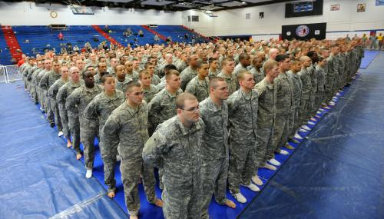
Competition
14 Dec: All participants are weighed in, and medically screened at Kieschnick Gym
15 Dec: Opening Ceremonies, all competitors in one mass formation in Kieschnick Gym, benediction, and opening comments
15 Dec: Preliminary Bouts / Standard Rules [Basic grappling in ACUs (no strikes or kicks)]
16 Dec: Quarter Final and Semifinal Bouts / Intermediate Rules. [Grappling in ACUs; open hand strikes and kicks allowed (competitors wear shin pads)]
Opening Ceremony Mass Formation

Slide 10
Competition
17 Dec: Finals / Advanced Rules [Competitors compete inside a tactical enclosure; ACU trousers and unit T-shirt, 4-oz gloves, closed fist strikes and kicks allowed]
16 total advanced rules bouts—8 bouts for 3rd and 4th Place and 8 bouts for 1st and 2nd. Awards presented immediately after each bout.
Kieschnick Gym setup with Tactical Enclosure for Combatives Finals

Slide 11
III Corps Combatives Championship Tournament Support
MISSION: Phantom Warrior Academy provides mission command of support requirements for the 2015 Fort Hood Combatives Tournament at Fort Hood from 14–17 Dec 15 IOT ensure the event is professionally executed.
Command and Control
CPT Curtis Loftin
1SG Jeremy Jackson
Tournament Director
SFC Timothy Farris
TM Med Screening
TM Med Support
TM Referee/ Judges
TM Setup/ Teardown
TM General Event
TM Garrison
BDE Surgeon
4 x Physicians
4 x 68Ws
BDE Surgeon
2 x Physicians
4 x 68W (NCOs)
6 x 68Ws
8 x Level 2 or 3
combatives
certified
8 x NCOs
44 x Soldiers
5 x NCOs
24 x Soldiers
MWR
PAO
DES
EMT Crew
FRG

Slide 12
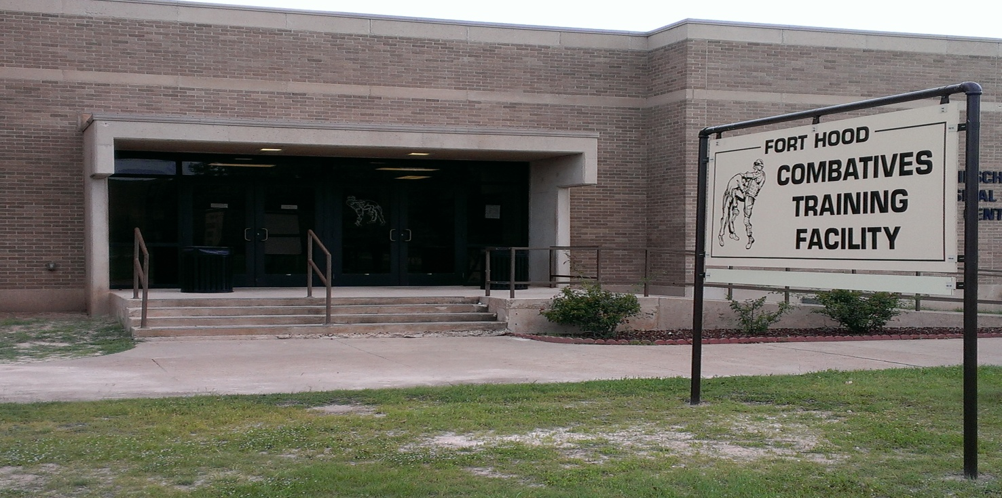
In-Processing & Set-Up
KEY TASKS
Medical Screening
Weigh, medically screen and approve
fighters for the tournament
General Support
Assist SFC Farris and staff with final
registration
Crowd Control
Print fight brackets at conclusion of
final registration
Setup/ Teardown
Setup chairs, tables, mats according
to layout
Garrison
PAO, continue to publicize event
MWR, provide chairs and tables for
TM Setup/ teardown
14-17 Dec15
Weigh –in
Final Registration
Print Fight Brackets
Medical Screening
~400 pax

Slide 13
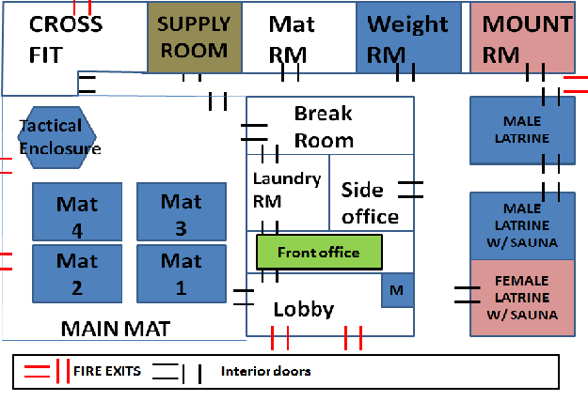
Tournament
Kieschnick Physical Fitness Center
KEY TASKS
Command and Control
Coordinate mobile Public Address
system (as backup)
Provide hand-held radios
Provide Master of Ceremony
Med Support
Provide on-site medical support
General Event
Provide crowd control
Provide assistance for details
Parking
Efficiently control traffic in parking lot
Ensure traffic lanes remain open
Garrison
PAO, coordinate for publicity and
filming
DES, coordinate for traffic control
one hour after final
DPW, provide barrier equipment/
tables, chairs an trophies
14 Dec 15
15 Dec 15
16 Dec 15
17 Dec 15
Reconfigure chairs and tables for Finals Bouts ~1500
Registration/ Weigh Ins 0900-1600
Preliminary Bouts 0900-UTC
QTR/ Semi Final Bouts 0900-UTC
Finals 1500-UTC

Slide 14
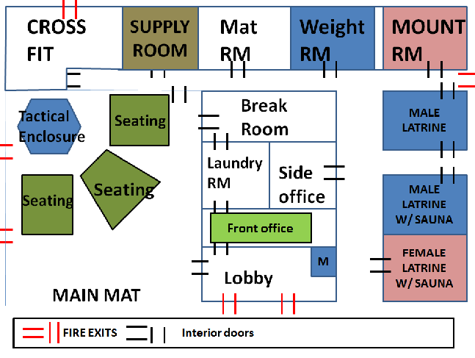
ADVANCED RULES/FINALS

Slide 15
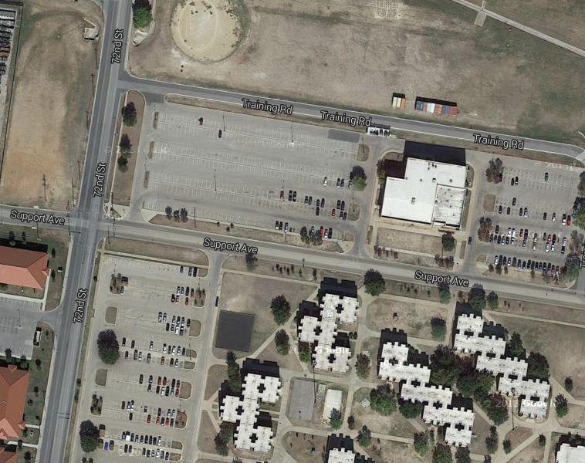
Tear Down & Recovery
Kieschnick Gym 72nd and support Ave Bldg 39008
TM Setup/ Teardown
Remove chairs and tables from
Kieschnick Gym
Return Kieschnick Gym to its original state
TM Garrison
PAO, capture video and pictures to
create motivational clip

Slide 16
PAO
INTERNAL Publicity/Coverage
PRE-TOURNAMENT
Internal information: Sentinel/Facebook/Twitter announcement of tournament beginning 02 NOV, with weekly follow-ups; fighter features starting 07 DEC edition and continuing through 17 DEC.
Photos (from feature articles) shared via III Corps/Fort Hood Flickr site.
- Facilitate media coverage; media advisory released 02 NOV by Media Relations Branch.
DAILY (14-17DEC)
- Preliminary round coverage: CI team uploads Flickr photos, acquires updates for social media posts; video clips uploaded to YouTube. Daily Facebook updates (morning after fights) providing highlights and team standings. MR escorts interested media.
- Championship round coverage: TV crew films all championship fights live-to-tape (for Fort Hood TV/Channel 10 airing afterward) and makes live feed available to interested media; internal print coverage to appear in Aug edition of Fort Hood Sentinel; Fort Hood Radio provides “call-back” interviews from venue during championship round during live broadcast on FortHoodRadio.com, including interviews with installation leaders, event organizers, team coaches, fighters, etc.
- MR facilitates media coverage.

Slide 17
DFMWR
Kieschnick Gym – Set-up 11 DEC 15
Media & Advertising – Flyers/Posters (posters already produced)
Public Address System from Kieschnick Gym
12 Tables, 150 chairs & trophies

Slide 18
Tournament Costs
III Corps Costs:
TBD
Costs Covered by Contributions from Non-Profits
• TBD

Slide 19
Recommendations / Decisions
1
CG’s participation
CG Opens the tournament 14 DEC 0900
CG Opens Finals Night 17 DEC 1500
CG / CSM Present Awards after each Championship bout and 1st Place team Award
BDE CDRs/CSMs wear ACUs during finals for visual command presence
CG/CSM Coins
CG / CSM present coin to each champion
A
APPROVE/DISAPPROVE
B
APPROVE/DISAPPROVE
C
APPROVE/DISAPPROVE
COA 1
APPROVE/DISAPPROVE
COA 2
APPROVE/DISAPPROVE
APPROVE/DISAPPROVE

Slide 20
Questions
&
Guidance

